Slide 1
APPLICATIONS
SCOPE
& OPPORTUNITY
OF BIOTECHNOLOGY
P. G. Dept. of Biosciences,
College of Pharmaceutical Sciences
At/Po: Mohuda, Berhampur-760002, Odisha
www.cpsbioscience.com

Slide 2
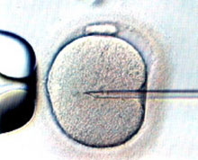
APPLICATIONS OF BIOTECHNOLOGY
Plant Science
Wide scale production of transgenic plants impacting agriculture in production of food, medicine etc.
Animal Science
Increased use of methods of in vitro fertilization and artificial insemination improve selected breed programs.
Wide scale production of transgenic animals impacting research.
P. G. Dept. of Biosciences,
College of Pharmaceutical Sciences
At/Po: Mohuda, Berhampur-760002, Odisha
www.cpsbioscience.com

Slide 3
APPLICATIONS OF BIOTECHNOLOGY
Environmental Science
Use of biotechnology techniques for cleaning contaminants and protecting endangered species
Immunoassay tests are used to test for the presence of contaminants in soil, water and even in blood.
Health/Agri-medicine
Pharming-the creation of plants and animals capable of producing medical substances
The use of biological barriers to prevent the spread of harmful microorganisms that could contaminate food sources
P. G. Dept. of Biosciences,
College of Pharmaceutical Sciences
At/Po: Mohuda, Berhampur-760002, Odisha
www.cpsbioscience.com

Slide 4
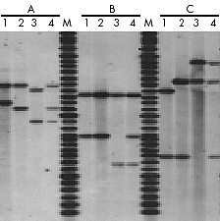
APPLICATIONS OF BIOTECHNOLOGY
DNA analysis/paternity testing has emerged as a technique to test the genetic ancestry of animals
P. G. Dept. of Biosciences,
College of Pharmaceutical Sciences
At/Po: Mohuda, Berhampur-760002, Odisha
www.cpsbioscience.com

Slide 5
APPLICATIONS OF BIOTECHNOLOGY
Scope of biotechnology is rising in certain fields which include: -
Gene therapy
Tissue culture
Enzyme engineering and technology
Plant-based drugs
New DNA technologies
Rational drug design
Immunotechnologies
Photosynthetic efficiency
Genetic Engineering
Stem cell techniques
P. G. Dept. of Biosciences,
College of Pharmaceutical Sciences
At/Po: Mohuda, Berhampur-760002, Odisha
www.cpsbioscience.com

Slide 6
GOVT. FUNDS
BIOTECH IN FOCUS IN 12TH FIVE YEAR PLAN
P. G. Dept. of Biosciences,
College of Pharmaceutical Sciences
At/Po: Mohuda, Berhampur-760002, Odisha
www.cpsbioscience.com

Slide 7
INDIAN BIOTECH SECTOR
P. G. Dept. of Biosciences,
College of Pharmaceutical Sciences
At/Po: Mohuda, Berhampur-760002, Odisha
www.cpsbioscience.com

Slide 8
P. G. Dept. of Biosciences,
College of Pharmaceutical Sciences
At/Po: Mohuda, Berhampur-760002, Odisha
www.cpsbioscience.com

Slide 9
P. G. Dept. of Biosciences,
College of Pharmaceutical Sciences
At/Po: Mohuda, Berhampur-760002, Odisha
www.cpsbioscience.com

Slide 10
P. G. Dept. of Biosciences,
College of Pharmaceutical Sciences
At/Po: Mohuda, Berhampur-760002, Odisha
www.cpsbioscience.com

Slide 11
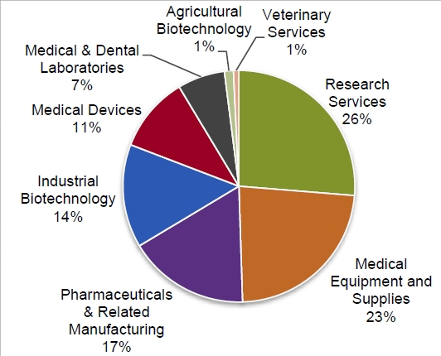
JOB PROSPECTS
PLACEMENT IN DIFFERENT SECTORS
P. G. Dept. of Biosciences,
College of Pharmaceutical Sciences
At/Po: Mohuda, Berhampur-760002, Odisha
www.cpsbioscience.com

Slide 12
JOB PROSPECTS
P. G. Dept. of Biosciences,
College of Pharmaceutical Sciences
At/Po: Mohuda, Berhampur-760002, Odisha
www.cpsbioscience.com

Slide 13
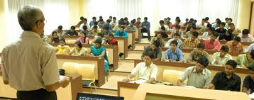
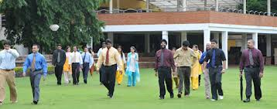
JOB PROSPECTS
Academia
Govt. & Private Universities and Colleges
As Faculty
As Research Fellow
As Research Advisor
As Consultants
P. G. Dept. of Biosciences,
College of Pharmaceutical Sciences
At/Po: Mohuda, Berhampur-760002, Odisha
www.cpsbioscience.com

Slide 14
JOB PROSPECTS
Research
At Central Laboratories Like
CSIR, ICAR, ICPGR, CSMCRI, IARI, IISC, CFTRI, NCL, NBRI, CDRI, CIMAP, IICB etc.
Govt. Research labs in Odisha
More than 40 Govt. Research labs in Odisha like NISER, IMMT, RMRC, CIFA, CRRI, ILS etc
Private Research Labs.
Clinical & Diagnostic Labs
P. G. Dept. of Biosciences,
College of Pharmaceutical Sciences
At/Po: Mohuda, Berhampur-760002, Odisha
www.cpsbioscience.com

Slide 15
JOB PROSPECTS
Non Govt. Organizations (NGOs)
That Works or takes projects on:
Environment monitoring and protection
Restoration of Degraded land
Biodiversity Conservation
Sanitation and health care
Environment & Energy
P. G. Dept. of Biosciences,
College of Pharmaceutical Sciences
At/Po: Mohuda, Berhampur-760002, Odisha
www.cpsbioscience.com

Slide 16
JOB PROSPECTS
Administration
D.B.T Administration
All India Biotech Association (AIBA)
Biotech Consortium India Limited
Rajiv Gandhi Centre for Biotechnology (RGCB)
Administrative Assistance
Administrative Co-ordinator
Administrative Director
P. G. Dept. of Biosciences,
College of Pharmaceutical Sciences
At/Po: Mohuda, Berhampur-760002, Odisha
www.cpsbioscience.com

Slide 17
JOB PROSPECTS
P. G. Dept. of Biosciences,
College of Pharmaceutical Sciences
At/Po: Mohuda, Berhampur-760002, Odisha
www.cpsbioscience.com

Slide 18
INFORMATIVE WEBSITES
www.dst.gov.in
www.dbtindia.nic.in
www.bioscienceindia.com
www.allaboutcareers.com
www.career.webindia123.com
www.minglebox.com
www.theguardian.com
www.biosciencecareers.wordpress.com
www.biospace.com
P. G. Dept. of Biosciences,
College of Pharmaceutical Sciences
At/Po: Mohuda, Berhampur-760002, Odisha
www.cpsbioscience.com

